Slide 1

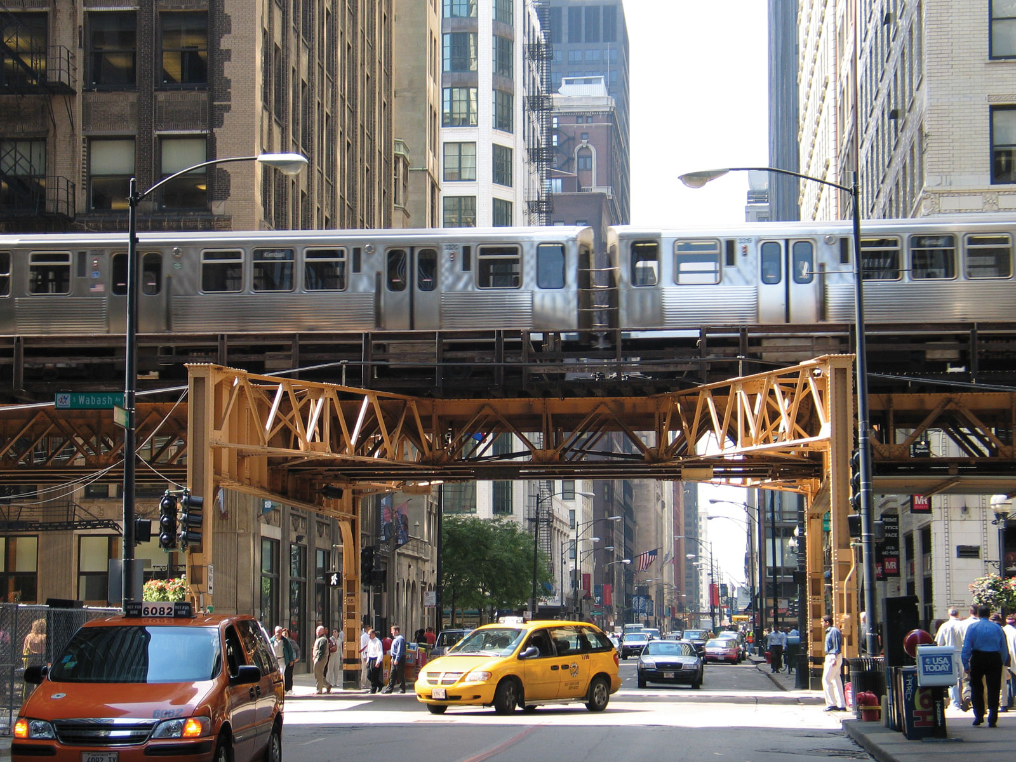
Changes in Ridership during COVID19
Transit ridership, and Covid19 case/hospitalization/death data obtained from the city of Chicago’s data portal (https://data.cityofchicago.org)

Slide 2
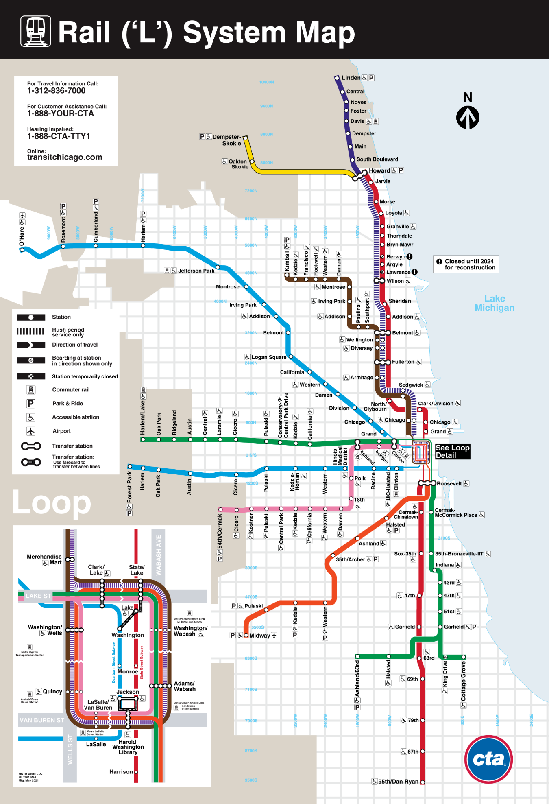
INTRODUCTION
Elevated trains operated by Chicago Transit Authority
Lines come together to connect in “the loop” in down Chicago
Sees 200+ million rides in a typical year

Slide 3
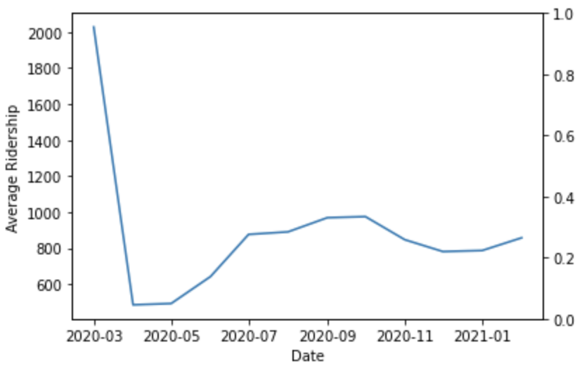
2020 Ridership
65.2% Decrease
Average Weekday Ridership
Annual Rail Ridership

Slide 4
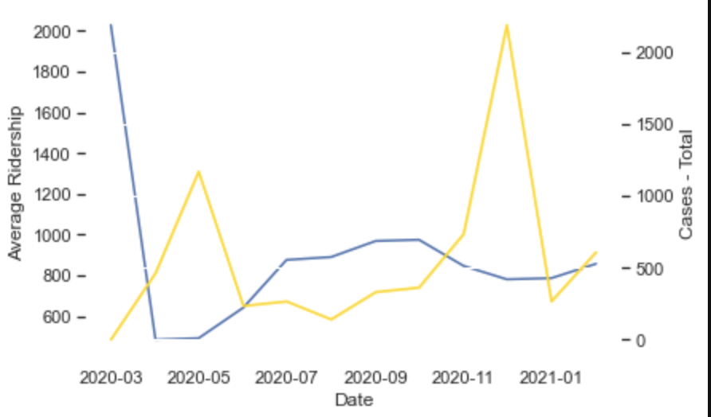
2020 Ridership
65.2% Decrease
236,000+
Average Weekday Ridership
Monthly Covid19 Cases
Annual Rail Ridership
Covid19 Cases

Slide 5
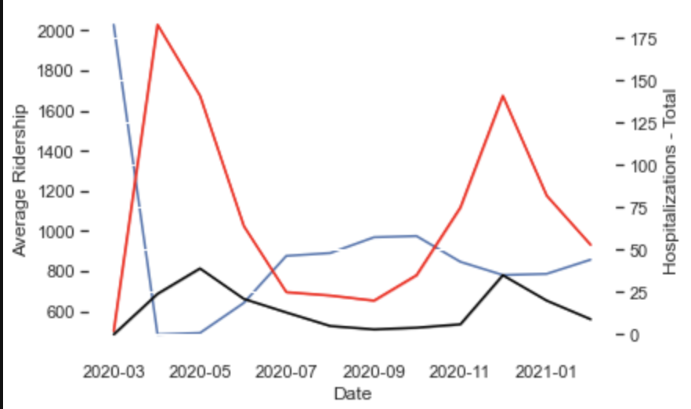
2020 Ridership
65.2% Decrease
236,000+
4795
4795
4795
4795 / 23622
Monthly Covid19 Hospitalizations
Average Weekday Ridership
Monthly Covid19 Deaths
Annual Rail Ridership
Covid19 Cases
Deaths / Hospitalizations

Slide 6
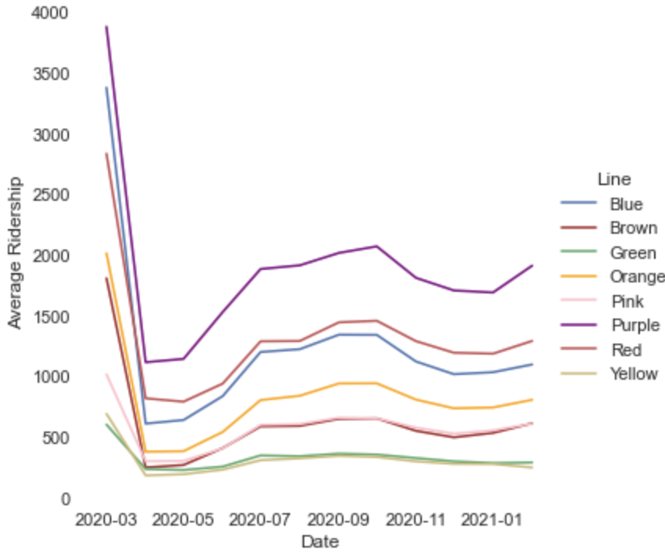
Breakdown by Line
March 20th
Stay-at-home Order
Statewide Stay-at-Home Order

Slide 7
Breakdown by Line
March 20th
October 29th
Statewide Stay-at-Home Order
New Restrictions
Pre-Thanksgiving Restrictions, Indoor Dining Banned

Slide 8
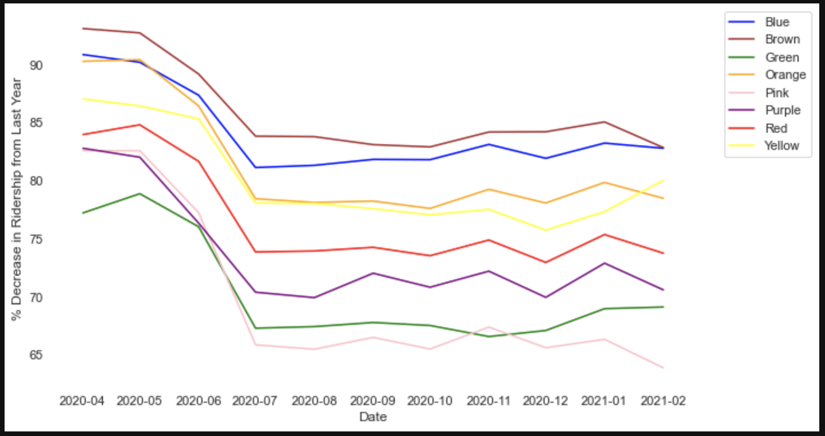
Ridership Recovery
Year-Over-Year Change
No Line back to 50% of Ridership
Percent Decrease in Ridership (Year-Over-Year)

Slide 9
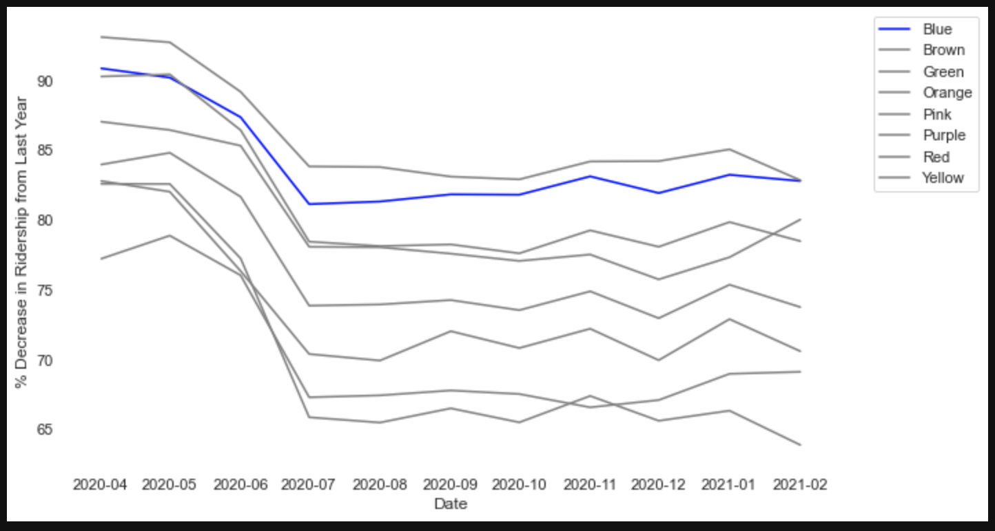
Ridership Recovery
Year-Over-Year Change
Blue Line to O’Hare Airport
No Line back to 50% of Ridership
One of the Slowest Recoveries
Percent Decrease in Ridership (Year-Over-Year)

